Slide 1

Creating Success Together
Making Every Moment Count

Slide 2
School Vision and what it means to Gold Class
Our Vision
"Every child matters, every moment counts".
In Gold Class everyone is important. We must always try our best and improve our learning. We must never give up!
Notes:
Warm welcoming
Informal
About building strong relationships with parents to make every moment count in school

Slide 3

Why do we want your child to come to school? What we have discussed with them

Slide 4
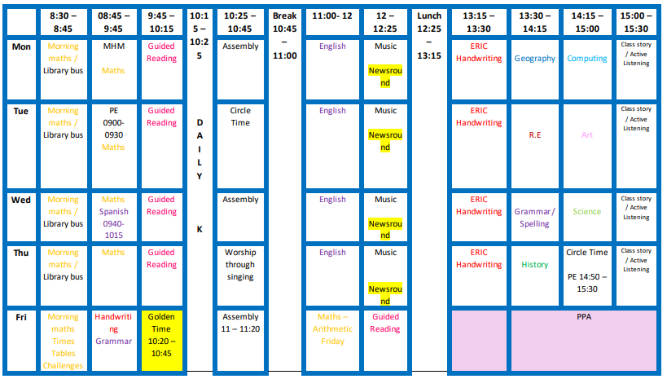
Our Learning
Children share learning - handwriting book and Maths book

Slide 5





Reading in Our Class (Share reading journals)

Slide 6
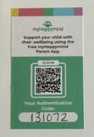
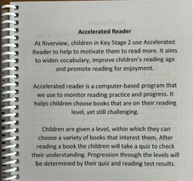
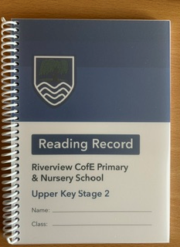
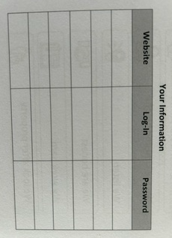
Reading Records

Slide 7

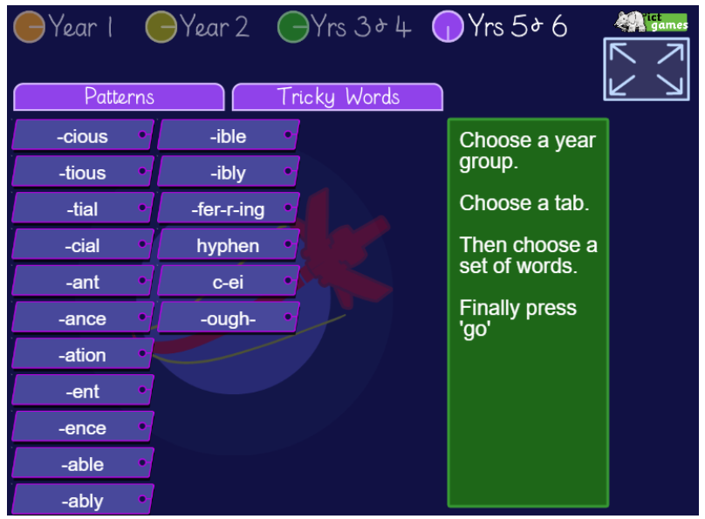

Google Classroom
Homework
15 minutes reading every day
30 minutes TTRS a week
ICT Games spelling rule – quiz every Monday

Slide 8
SATs
Monday 10 May: English grammar, punctuation, and spelling (Paper 1: short answer questions, and Paper 2: spelling).
Tuesday 11 May: English reading test.
Wednesday 12 May: Mathematics Paper 1 (Arithmetic) and Mathematics Paper 2 (Reasoning).
Thursday 13 May: Mathematics Paper 3 (Reasoning).

Slide 9
Dates to see how your child is doing in school
Art Exhibition – Wednesday 14th October
Walk in Wednesdays – look out for your class date!
Time for Talk – look out for your class date!

