Slide 1
Riverview C of E Primary School
Online safety workshop
Thursday 10th February
Mrs Barnett (SENCO/Computing lead)
Online safety Quiz

Slide 2
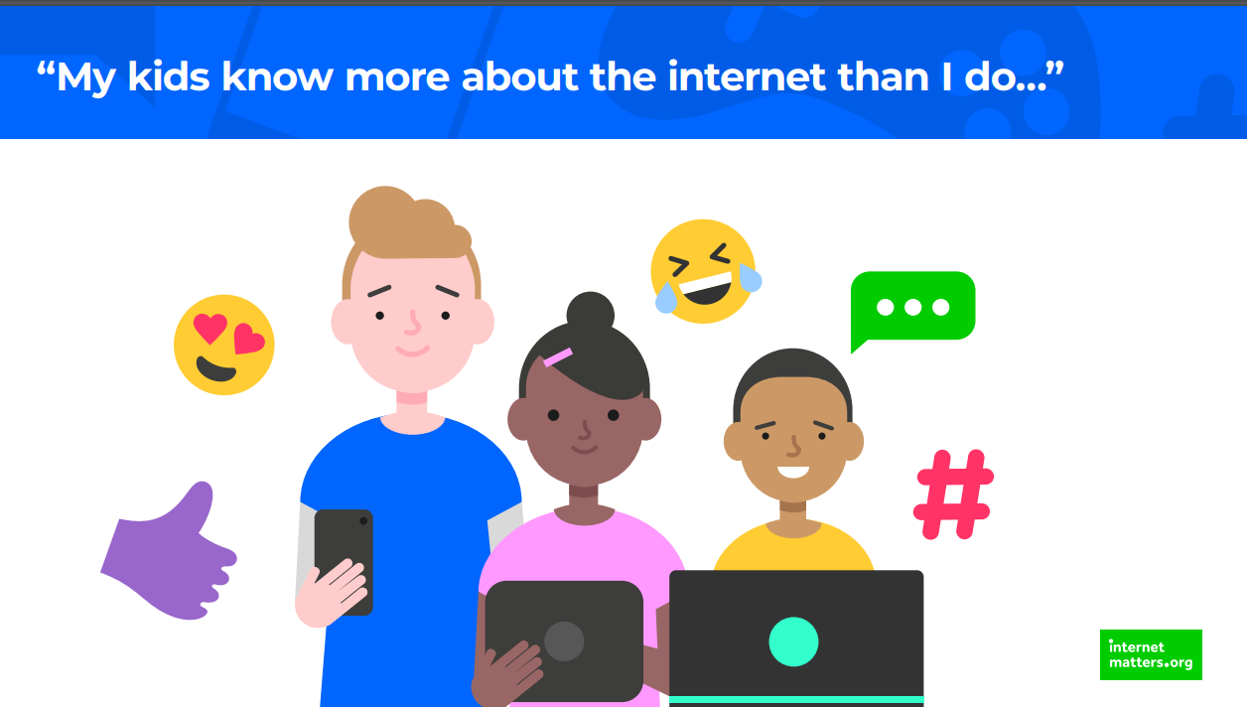

Slide 3
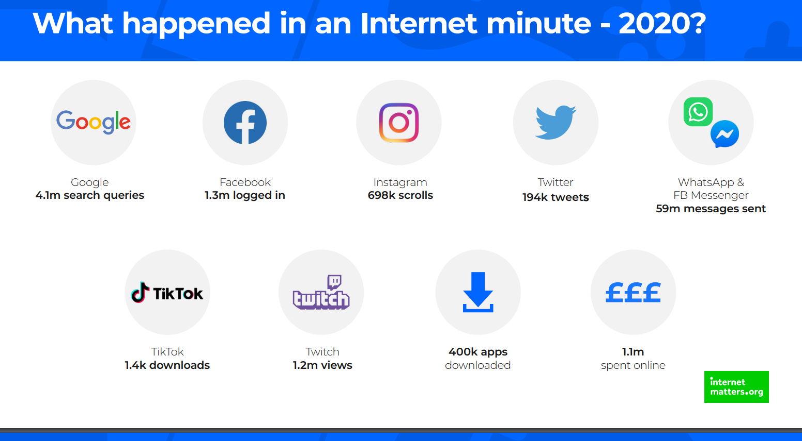

Slide 4
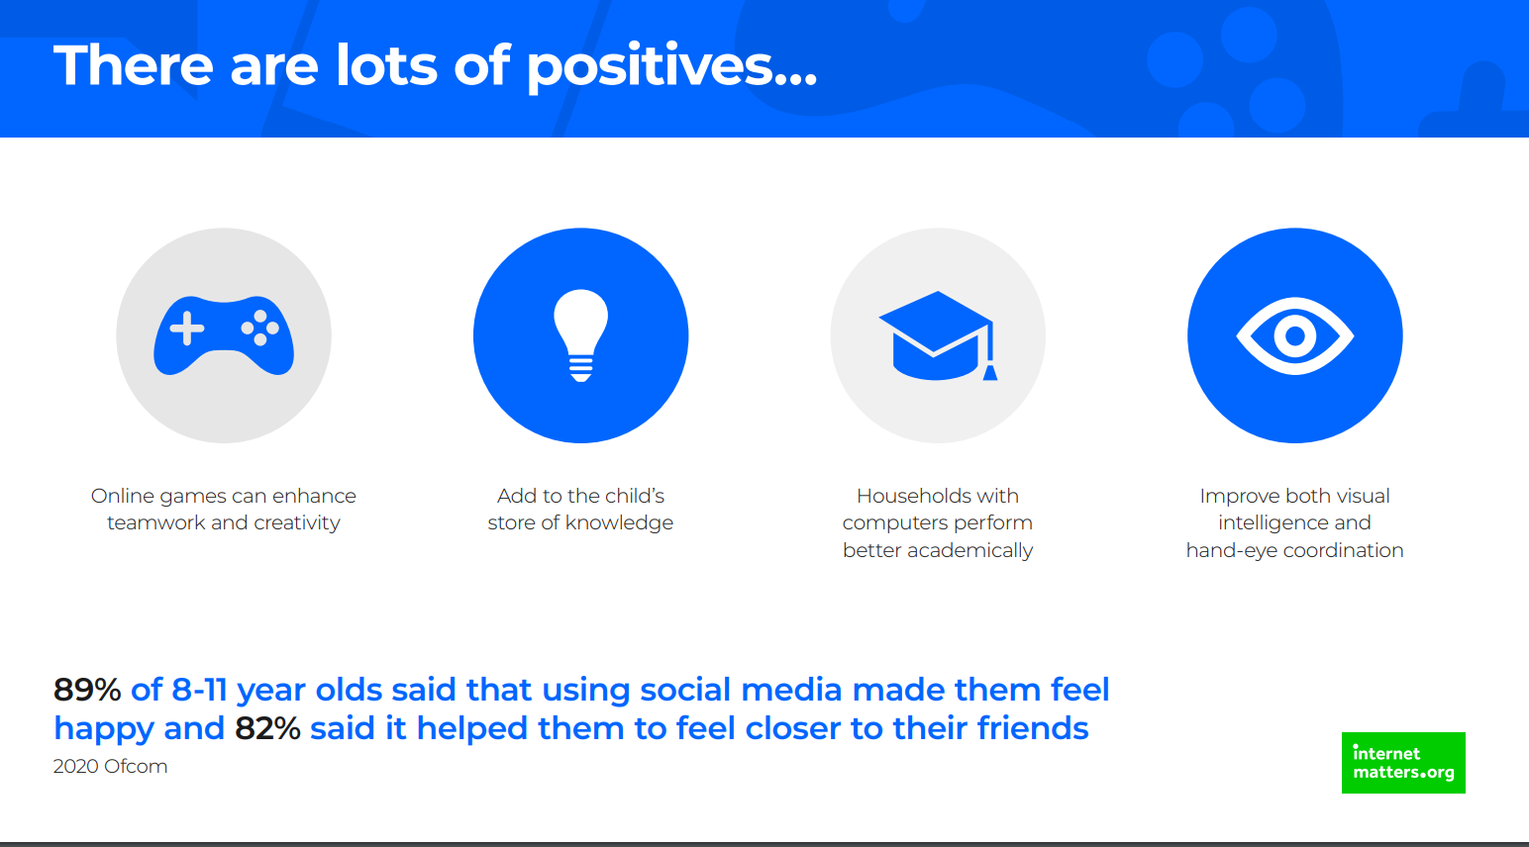

Slide 5
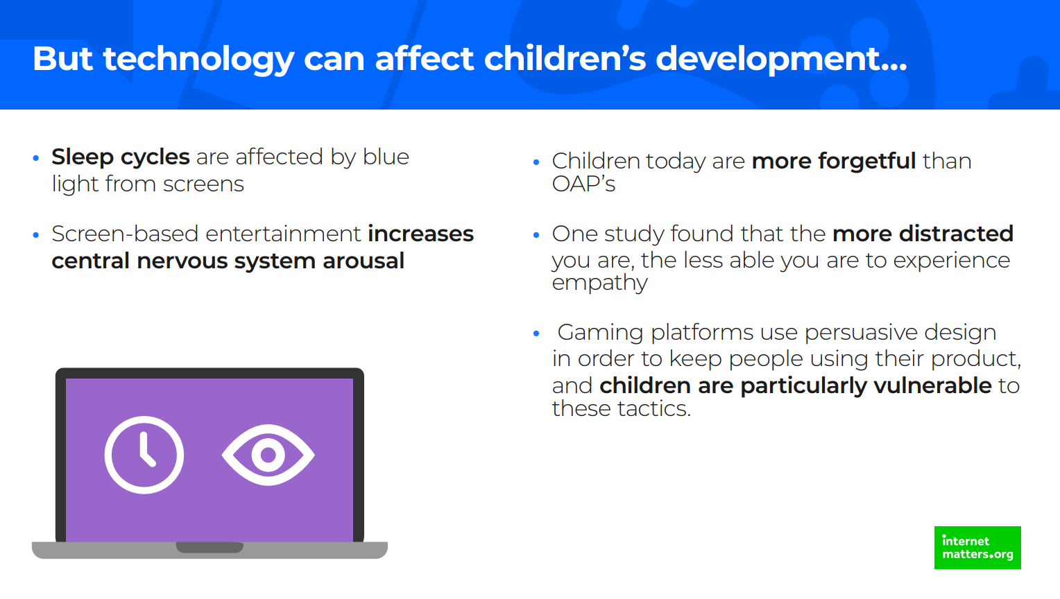

Slide 6
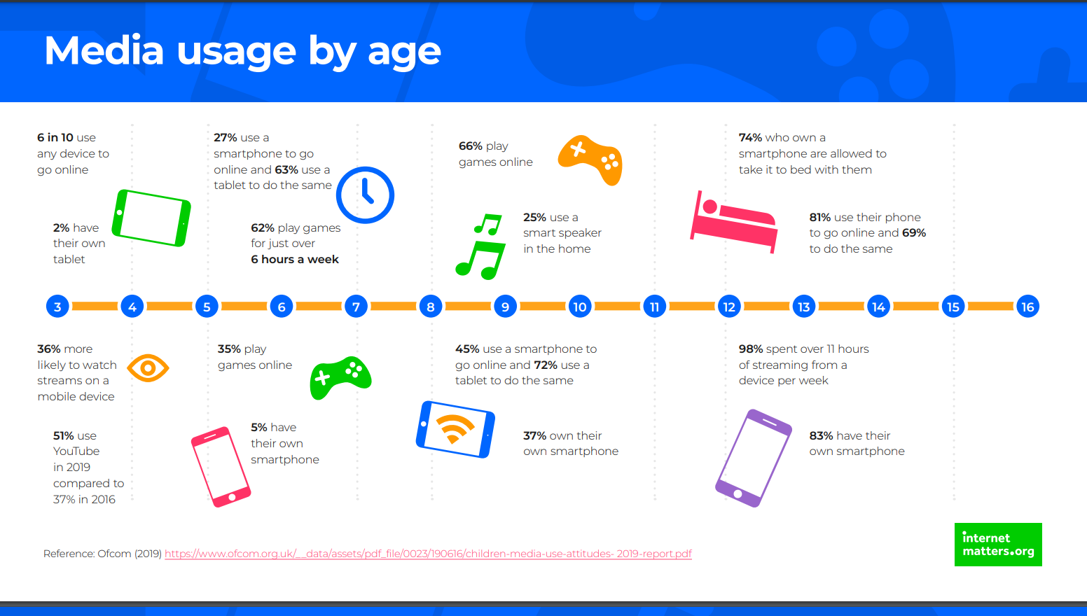

Slide 7
Risks of using the internet
Risks fall into one or more of these categories:
Contact
Content
Conduct
Cyber scams

Slide 8
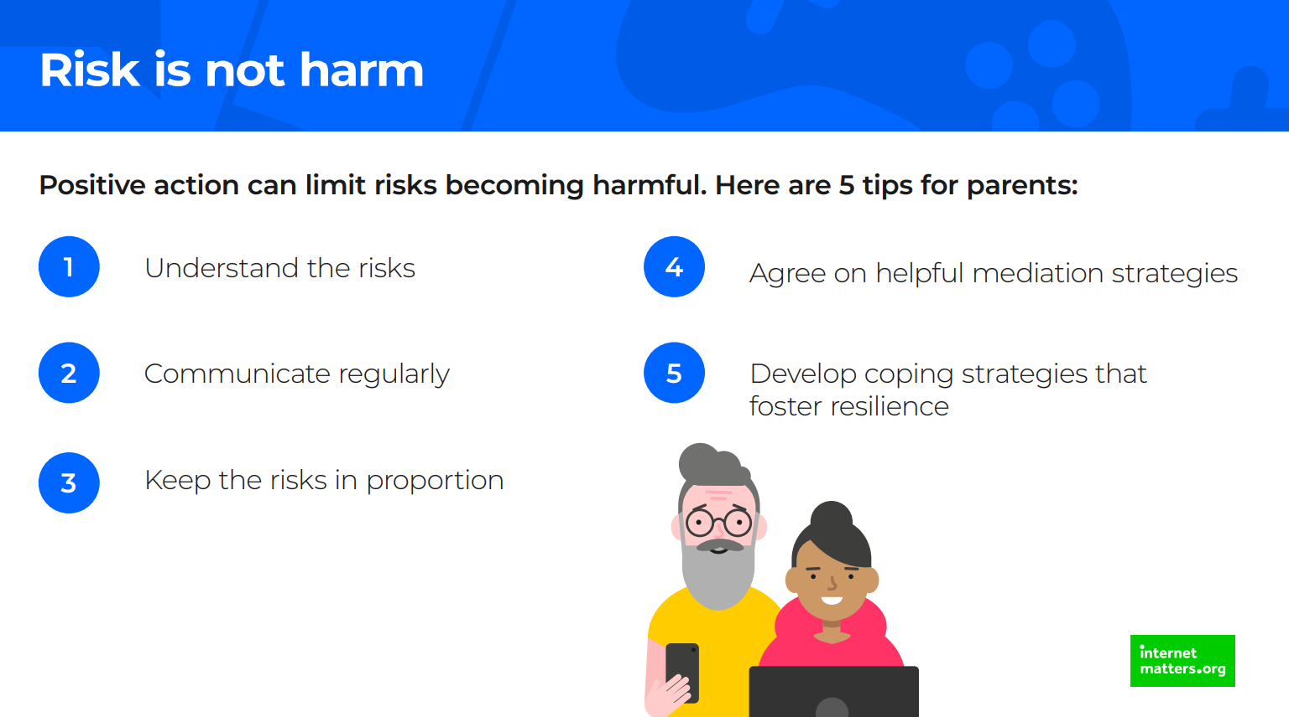

Slide 9
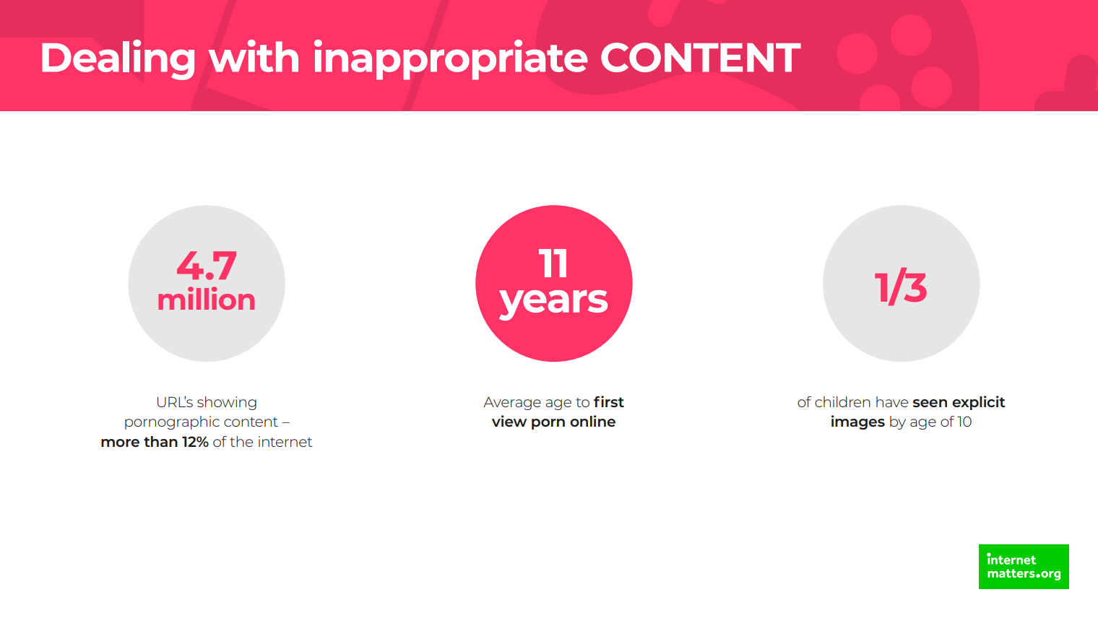

Slide 10
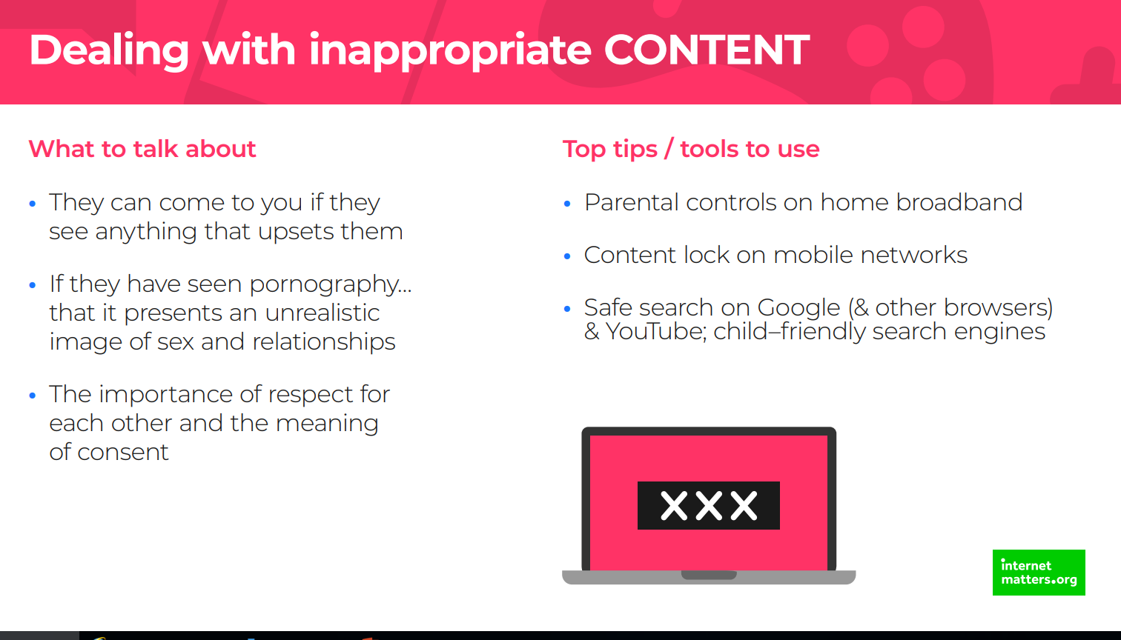
kiddle
swiggle

Slide 11
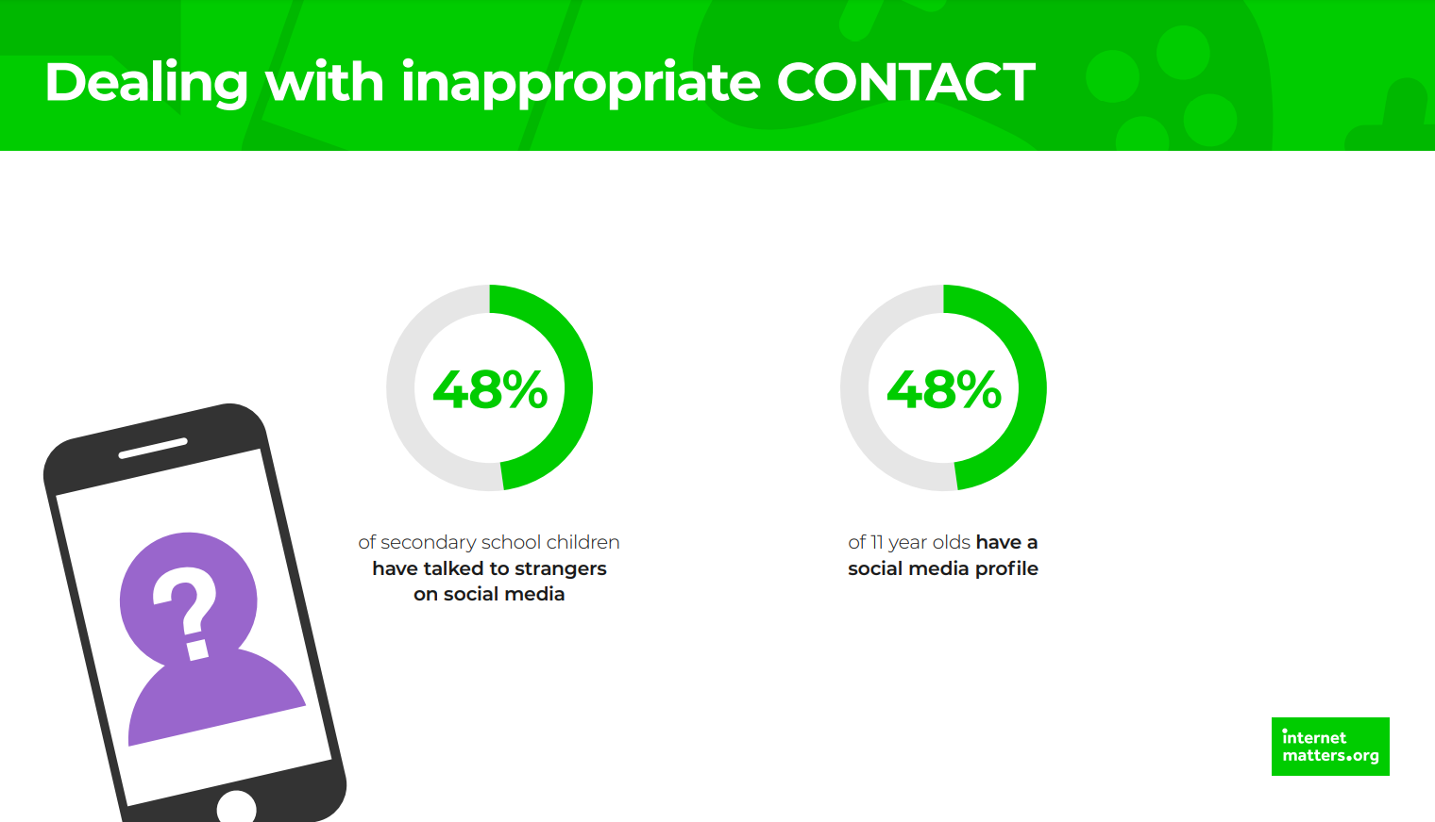

Slide 12
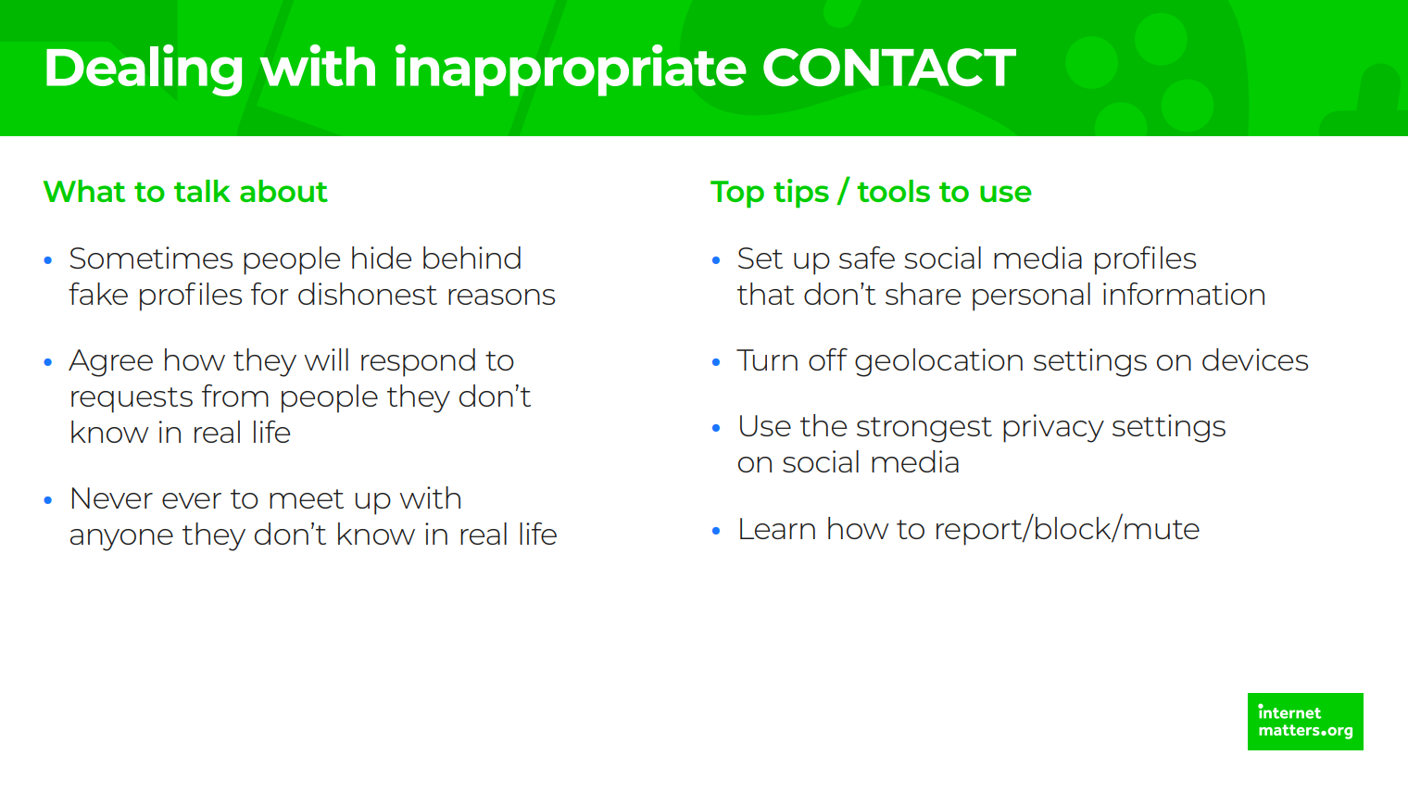

Slide 13
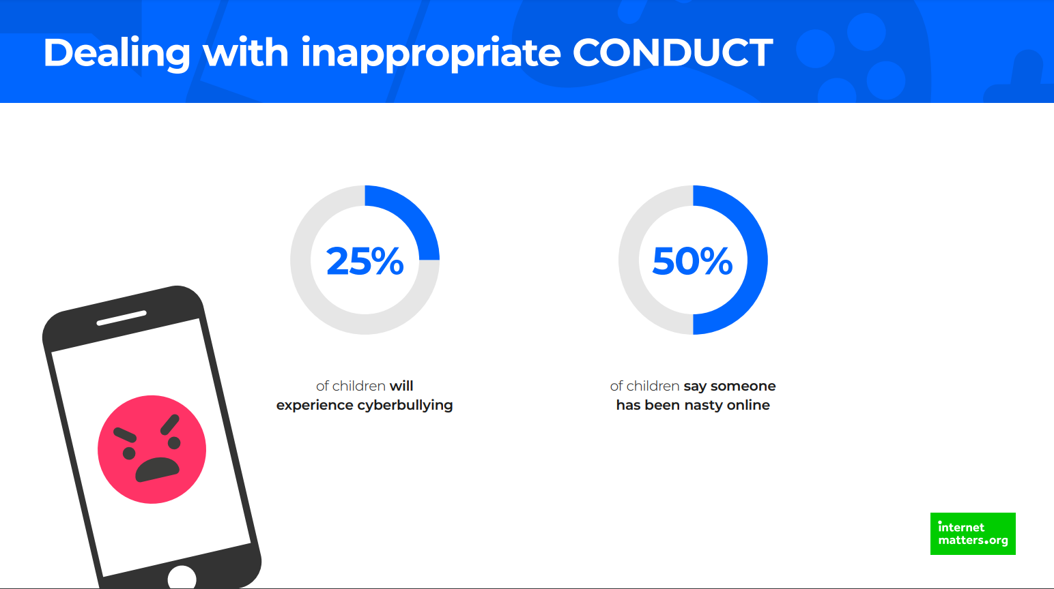

Slide 14
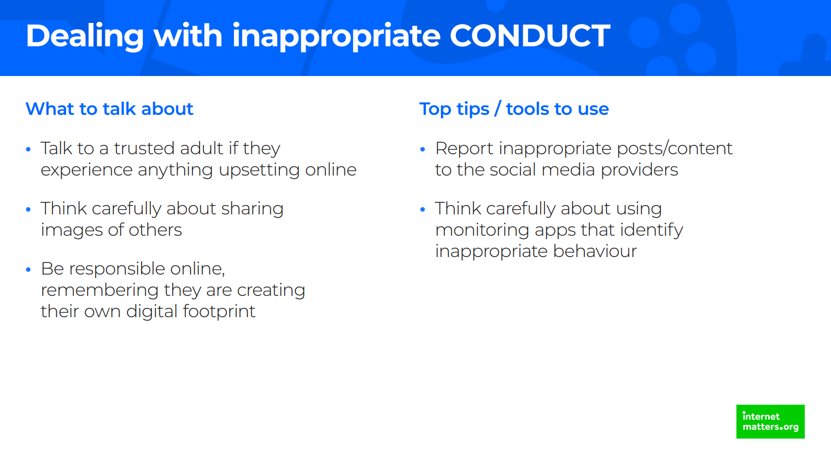

Slide 15
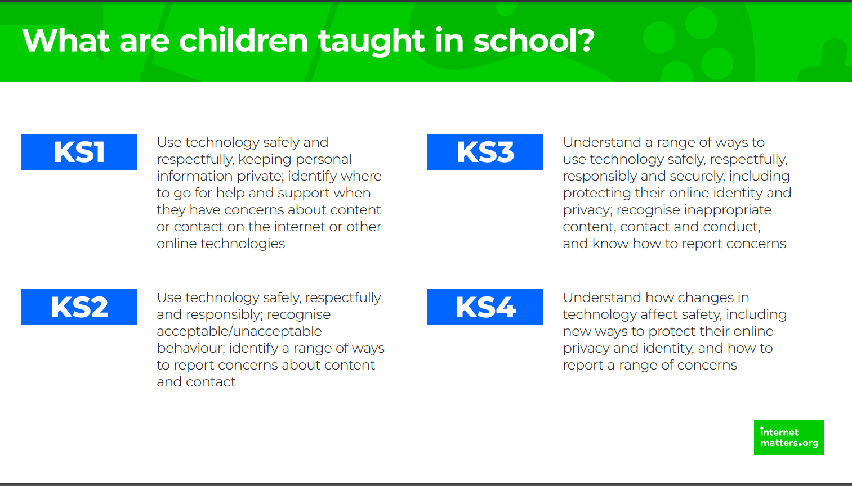
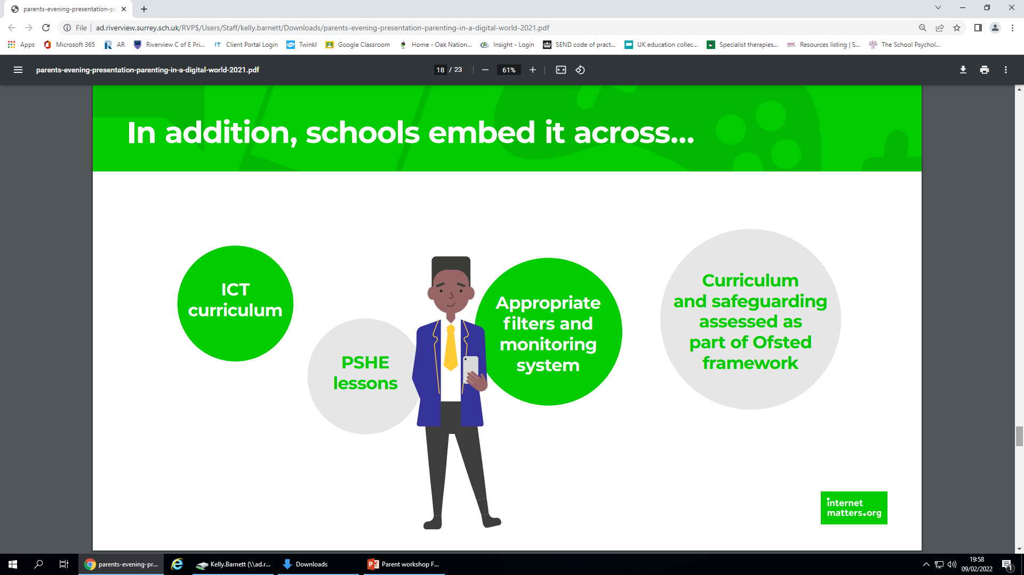
We want our children to be: safe, responsible & respectful

Slide 16
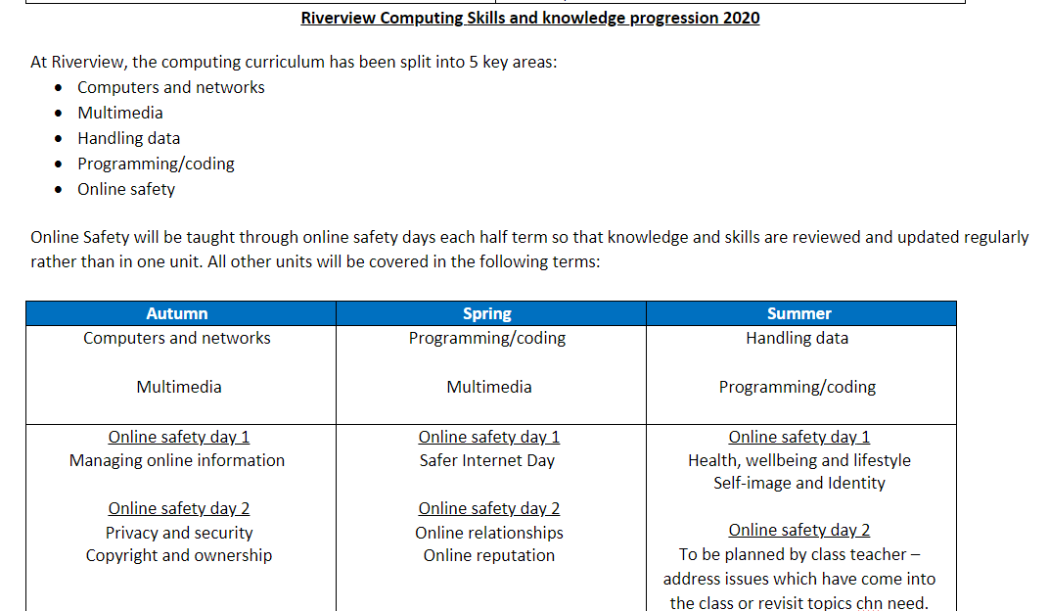

Slide 17
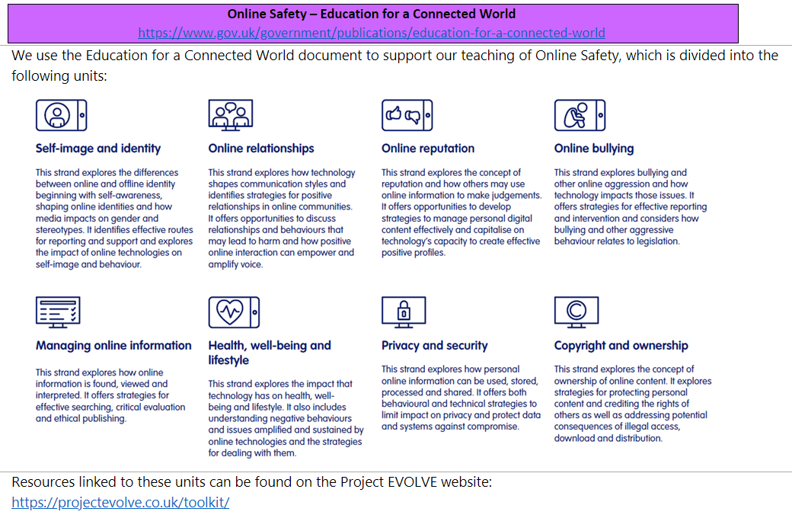

Slide 18
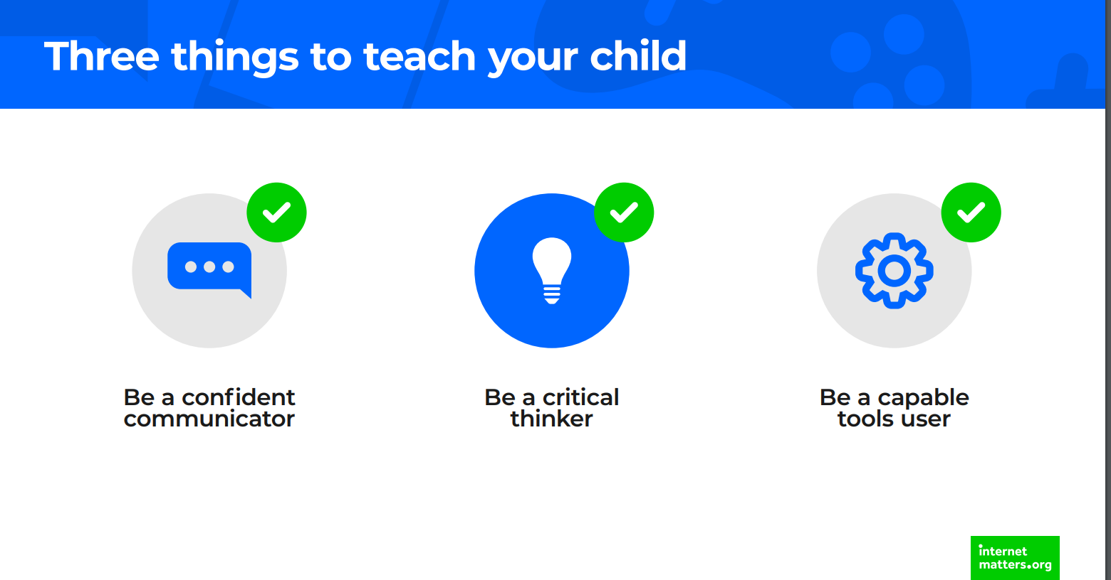
respectful
responsible
safe

Slide 19
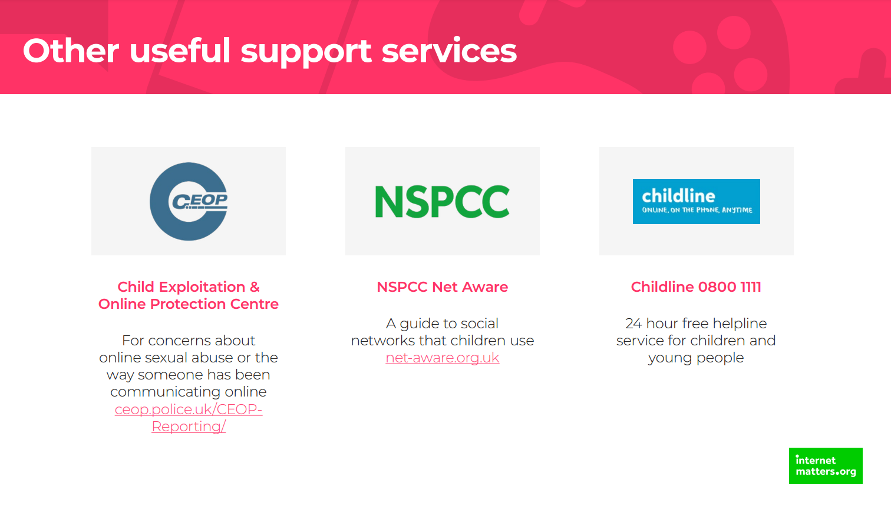

Slide 20
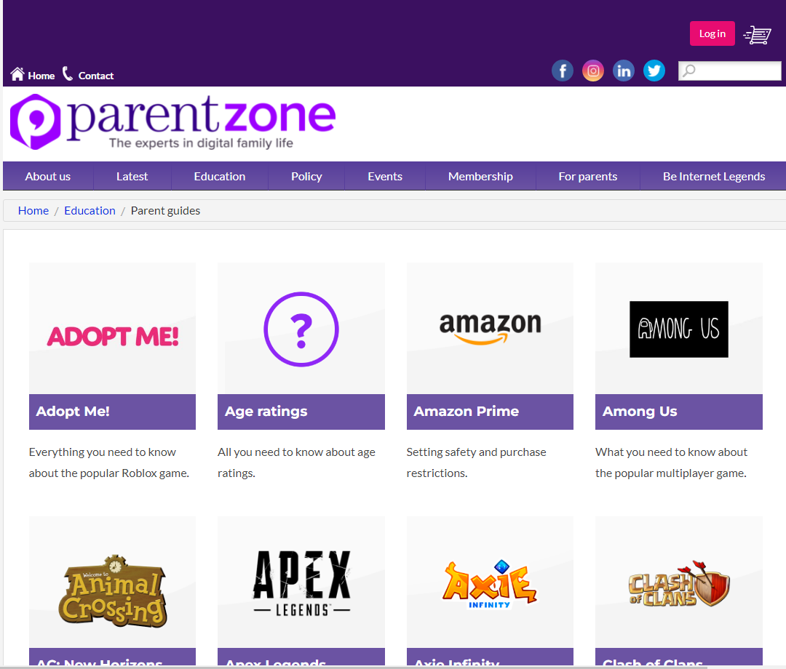
https://parentzone.org.uk/advice/parent-guides

Slide 21
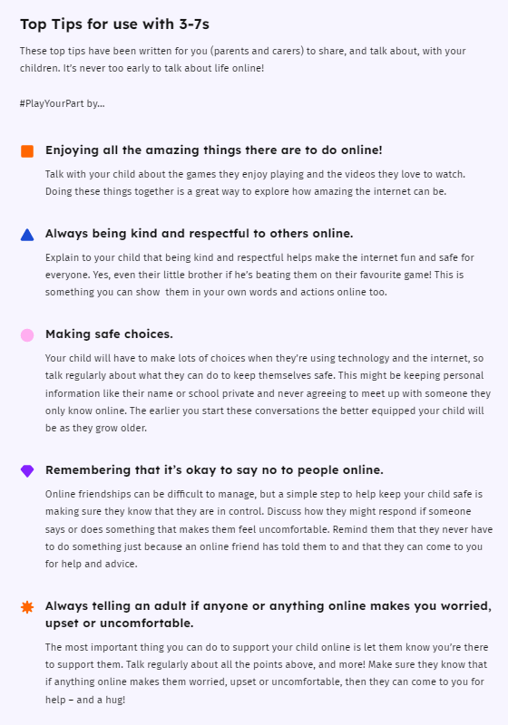
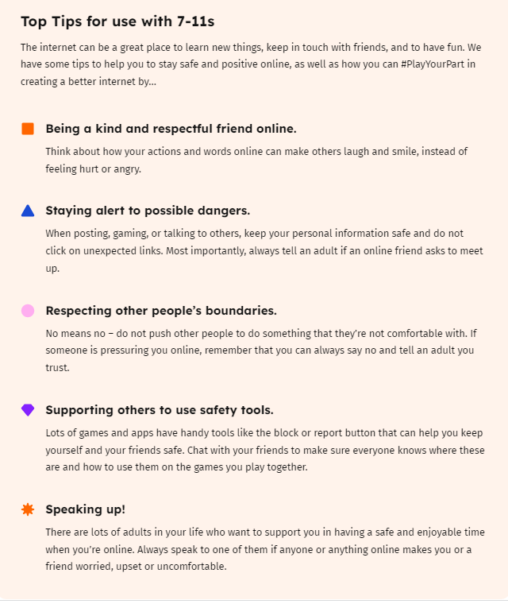

Slide 22


