Slide 1
Maths Fluency
Parent’s Workshop
Every child matters, every moment counts
Riverview exists to love, challenge and inspire children and adults within a Christian community.

Slide 2
Aims
To provide an overview of progression in key number facts across the school
To explore key strategies to promote recall of number facts and improve maths fluency

Slide 3
Maths National Curriculum
Fluency
Reasoning
Problem Solving

Slide 4

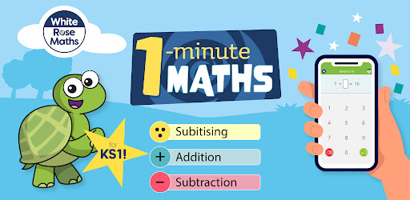
White Rose Maths App

Slide 5
What are number facts?
Children are expected to memorise a number of different number facts in primary school, including number bonds to 20 ( + and -) and the multiplication and division facts for tables up to the twelve times tables.

Slide 6

Year 1
In Year 1 children learn and use the addition and subtraction facts to 10 and move onto number bonds to 20.
• It is not enough that they can just ‘say’ the numbers to 20… do they understand what that number means?
• This means they will become familiar with and practise all the different combinations of adding and subtracting numbers to a total of 10 and 20.
• For example, 2 + 8 = 10, 10 – 6 = 4, 17 – 5 = 12, 5 + 3 = 8, 20 – 9 = 11

Slide 7
Year 2
In Year 2 children consolidate their knowledge of number facts to 20 and develop fluency when recalling the facts (learn them off by heart).
There are games on the computer to help keep this fun.
Children also learn to use the number bonds to 20 to derive related facts up to 100
For example, if they know that 2 + 3 = 5 then they can understand that 20 + 30 = 50.

Slide 8
Year 2
Also, multiplication and related division facts for the 2, 5 and 10 times tables are learned in Year 2.
For example, for the 2x table:
1 x 2 = 2 and 2 ÷ 2 = 1
2 x 2 = 4 and 4 ÷ 2 = 2
3 x 2 = 6 and 6 ÷ 2 = 3
4 x 2 = 8 and 8 ÷ 2 = 4
5 x 2 = 10 and 10 ÷ 2 = 5
6 x 2 = 12 and 12 ÷ 2 = 6
7 x 2 = 14 and 14 ÷ 2 = 7
8 x 2 = 16 and 16 ÷ 2 = 8
9 x 2 = 18 and 18 ÷ 2 = 20
10 x 2 = 20 and 20 ÷ 2 = 10
11 x 2 = 22 and 22 ÷ 2 = 11
12 x 2 = 24 and 24 ÷ 2 = 12

Slide 9
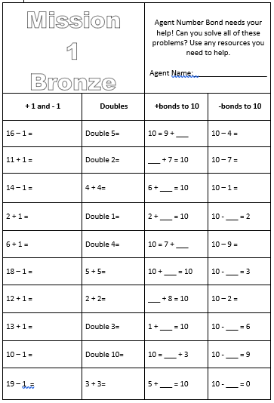
Number Missions
Year 1 and 2
Reception in summer term

Slide 10
Year 3
In Year 3 children learn multiplication and related division facts for the 3, 4 and 8 times tables.
Children will also be taught the connection between the 2, 4 and 8 times tables through doubling and halving.
(so if 2 x 3 = 6 then 4 x 3 = 12 ).

Slide 11
Riverview Times Table Challenges
Award | Multiplication/Division Range | Number of Questions | Time | Questions per Minute
Bronze | 2x 5x 10x | 24 | 3 mins | 8
Silver | As above plus 3x 4x 8x | 36 | 3 mins | 12
Gold | As above plus 6x 7x 11x | 48 | 3 mins | 16
Platinum | All up to 12x12 | 60 | 3 mins | 20
Diamond | All up to 12x12 | 100 questions | 4 mins | 25
Ultimate Challenge | All up to 12x12 | 144 questions | 4 mins | 36
Current champion 1m 39 seconds

Slide 12

Year 4
In Year 4 children learn multiplication and related division facts for the 6, 7, 9, 11 and 12 times tables so that they know them all.
From this year, there is a multiplication tables check test at the end of Year 4.

Slide 13
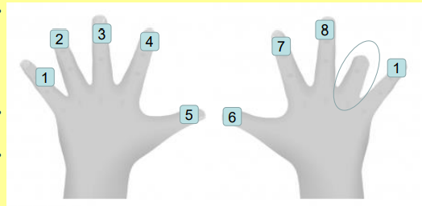
9 times table trick
Hold both hands up in front of you. Whatever you’re multiplying by (for example 9), hold down that finger.
The fingers to the left of the bent finger are the tens (in this case 80), and the fingers to the right the ones (in this case 1 ) 9 x 9 = 81.
All times tables
Make up rhymes and mnemonics, for example: Eight times eight fell on the floor, pick it up it's sixty four.

Slide 14
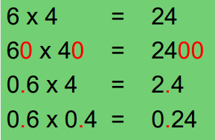
Year 5 and 6
In the last two years of KS2 children practise and improve their mental recall of multiplication and division facts up to 12 x 12.
They will also use and apply these facts in more complex calculations.

Slide 15
A firm knowledge of number bonds and multiplication and division facts are essential, especially as calculators are no longer allowed in Year 6 SATs.

Slide 16
Using what you know to help
Use what you know to help with what you don’t:
Teachers tell children this from EYFS onwards, but it’s really important to remember it, even when doing maths at secondary school (and beyond).
When working with numbers there are often patterns to be found which can really help you to work out calculations.
For example:
2.30 + 5.70
Note the number bond to 10 in the decimals, so that makes 1
Add 1 to the two whole numbers: 2 + 5 + 1 = 8

Slide 17
Checking answers – does that look right?
• When you’ve completed a calculation, take a moment to look at it and the answer. Ask, does that look right?
• For example, you can help to check answers by getting into the habit of doing rough calculations prior to completing the answer and seeing if they are approximately right or by using the inverse operation (so addition to check subtraction and vice versa and multiplication to check division)

Slide 18
The value of playing games in Maths
Games give children opportunities to explore fundamental number concepts, and can also encourage students to explore number combinations, place value, patterns, and other important mathematical concepts.
Children can deepen their mathematical understanding and reasoning.
Children should be provided with repeated opportunities to play games, to let the mathematical ideas emerge as students notice new patterns, relationships, and strategies.
Games are an important tool for learning mathematics:
• Playing games encourages strategic mathematical thinking as children find different strategies for solving problems and deepen their understanding of numbers.
• When played repeatedly, games support students’ development of computational fluency.
• Games present opportunities for practice, often without the need for others to provide the problems.

Slide 19
What can you do to help at home?
Handout KS1
Handout KS2

